Slide 1
Risk Management

Slide 2
Risk Management
Risk Identification
Risk Assessment
Risk Analysis
Risk Prioritization
Risk Management
Risk Management Planning
Risk Control
Risk Resolution
Risk Monitoring

Slide 3
Risk Identification
Most Common Schedule Risks
  Feature creep
  Requirements or development gold-plating
  Shortchanged quality
  Overly optimistic schedules
  Inadequate design
  Silver-bullet syndrome
  Research oriented development
  Weak personnel
  Contractor failure
  Friction between developers and customers

Slide 4
Risk Analysis
Risk identified
  Probability of loss (%)
  Size of loss (weeks or dollars or …)
  Risk exposure (weeks or dollars or …)

Slide 5
Risk Prioritization
Helps to identify the most important risks
Plan mitigation
Assign resources as needed

Slide 6
Risk Control
Risk management planning
Risk resolution
  Avoid the risk
  Transfer the risk from one part of a system to another
  Buy information about the risk
  Estimate the root cause of the risk
  Assume the risk
  Publicize the risk
  Control the risk
Risk monitoring

Slide 7
Steps in risk management
Checklist
Decomposition
Risk assessment
Risk identification
Assumption analysis
Decision driver analysis
System dynamics
Performance models
Cost models
Risk analysis
Network analysis
Decision analysis
Risk management
Quality risk factor analysis
Risk prioritization
Risk exposure
Compound risk reduction
Buying information
Risk avoidance
Risk reduction
Risk transfer
Risk reduction leverage
Development process
Risk control
Risk management planning
Risk element planning
Risk plan integration
Risk mitigation
Risk resolution
Risk monitoring and reporting
Risk reassessment

Slide 8
Risk Exposure
Risk Exposure (RE) – expected value of a loss due to a particular risk
  The higher the RE, the higher the priority of the risk item
RE = Prob(UO) * Loss(UO)
  Prob(UO) is the probability of the risk materializing (i.e., undesirable outcome).
  Prob(LO) is the total loss incurred due to the unsatisfactory outcome.

Slide 9
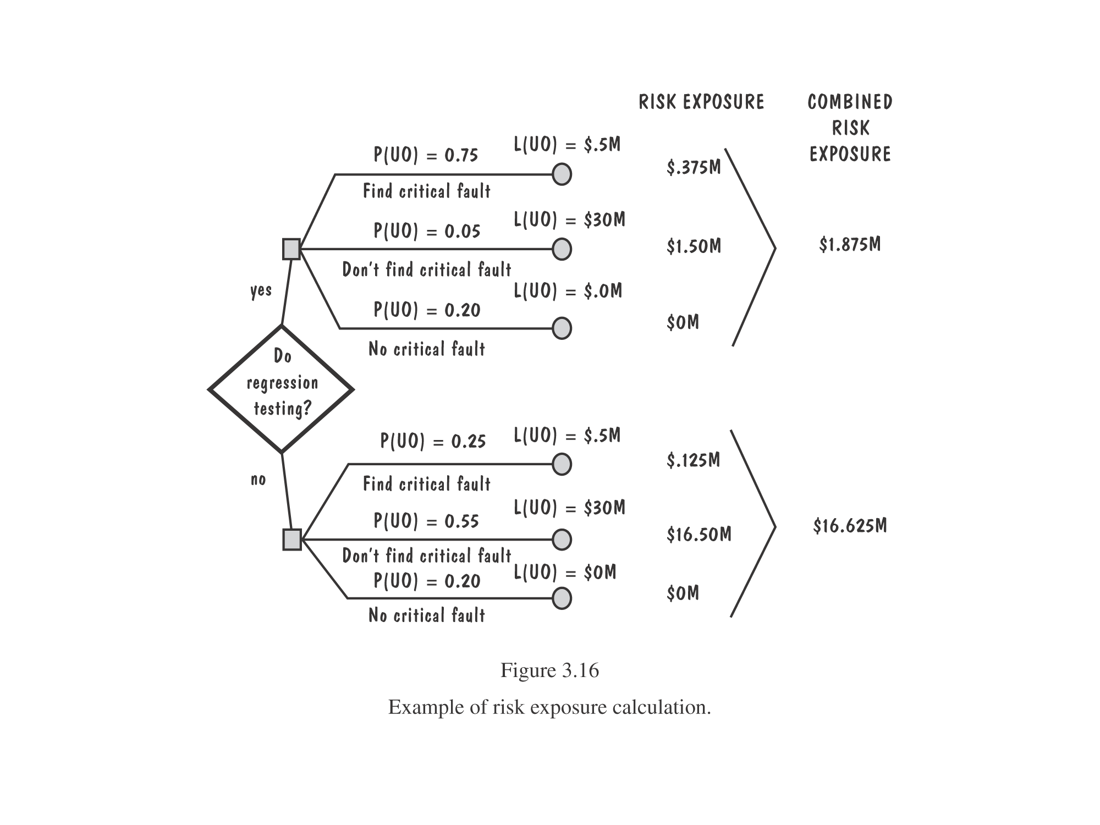
Example of risk exposure calculation

Slide 10
Risk Management Plan
Seq Num. | Prob. | Risk | Impact | Exp. | Mitigation Plan
1 | Failure to meet the high performance | High | High | High | Study white papers and guidelines on performance. Train team on performance tuning. Update review checklist to look for performance pitfalls. Test application for performance during system testing.
2 | Lack of people with right skills | Med. | Med. | Med. | Train resources Review prototype with customer Develop coding practices

Slide 11
Risk Management Plan
Seq Num. | Prob. | Risk | Impact | Exp. | Mitigation Plan
3 | Complexity of application | Med. | Med. | Med. | Ensure ongoing knowledge transfer Deploy persons with prior experience with the domain
4 | Manpower attrition | Med. | Med. | Med. | Train a core group of four people Rotate assignments among people Identify backups for key roles
5 | Unclear requirements | Med. | Med. | Med. | Review a prototype Conduct a midstage review

